Slide 1

Chat System
2023 Spring ICS Final Project
Wenbo Lu wl2707
& Kaylee Xu jx2279
Instructed by prof. Xianbin Gu

Slide 2


TABLE OF CONTENTS
01
02
03
04
Introduction
What is our project and motivations
Demo
How our project looks
Potential Improvements
What can be improved
Discussion
What’s unique in our developing process

Slide 3

01
Introduction
GUI & Secure Messaging & Game

Slide 4
Definition and Motivation
Definition
A GUI-based chat system with secure messaging and a built-in online game Gomoku
Motivation: User-centered design
User-friendly Graphic User Interface (GUI)
Security and Privacy
Fun and pleasure when chatting

Slide 5
GUI functions
01 | Login/Signup window
For those who comes to our chat system for the first time, they need to sign up and create an account. For those who already have an account, they can directly sign in.
02 | Chat & Emoji
After logging in, users can connect other online users and send messages (secured) to chat freely. We provide 20 emojis for users to send to enhance the pleasure of chatting.
03 | Game trigger
There is a built-in minigame Gomoku for users to have fun.

Slide 6
Secure Messaging
01 | What is secured messaging
Confidentiality, integrity, authenticity
02 | Why do we need secure messaging
Data and information security matters
03 | How do we secure our messaging
Through algorithms, and here we use RSA

Slide 7
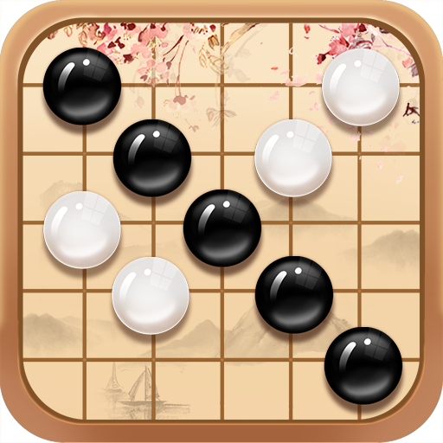
Game - Gomoku
01 | Win: Five in a row
02 | Round time countdown
03 | Auto placement

Slide 8
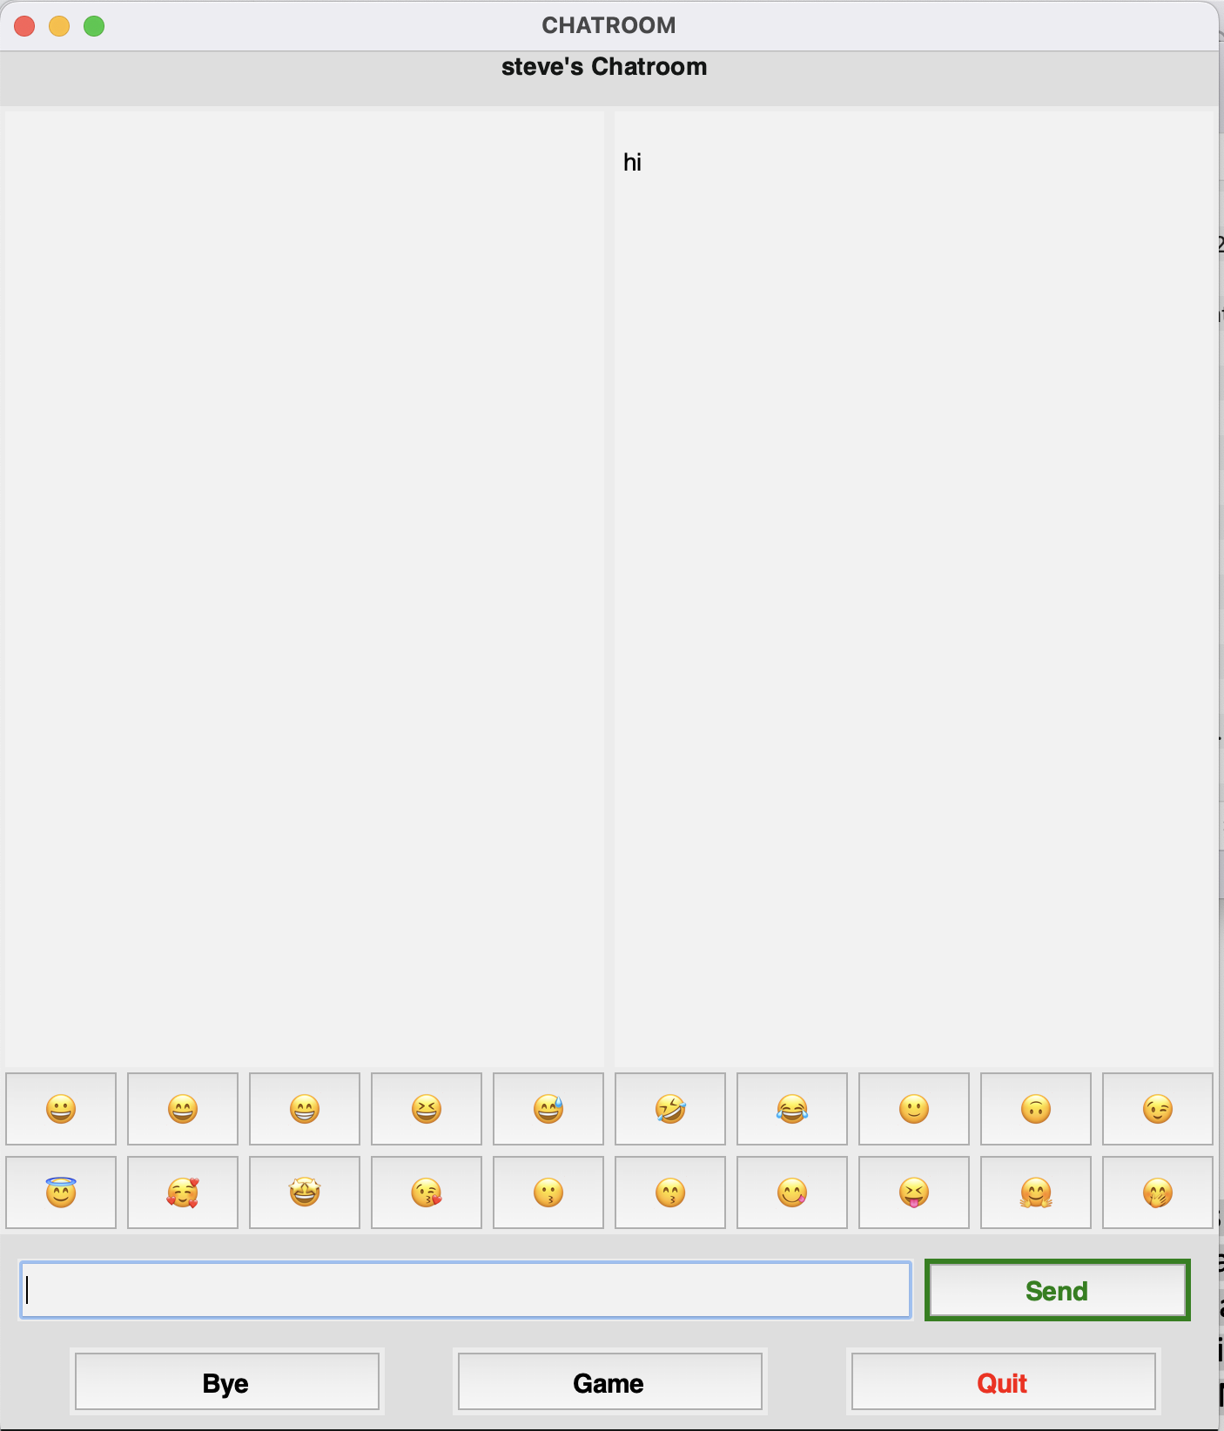
02
Demo

Slide 9
03
Discussion

Slide 10
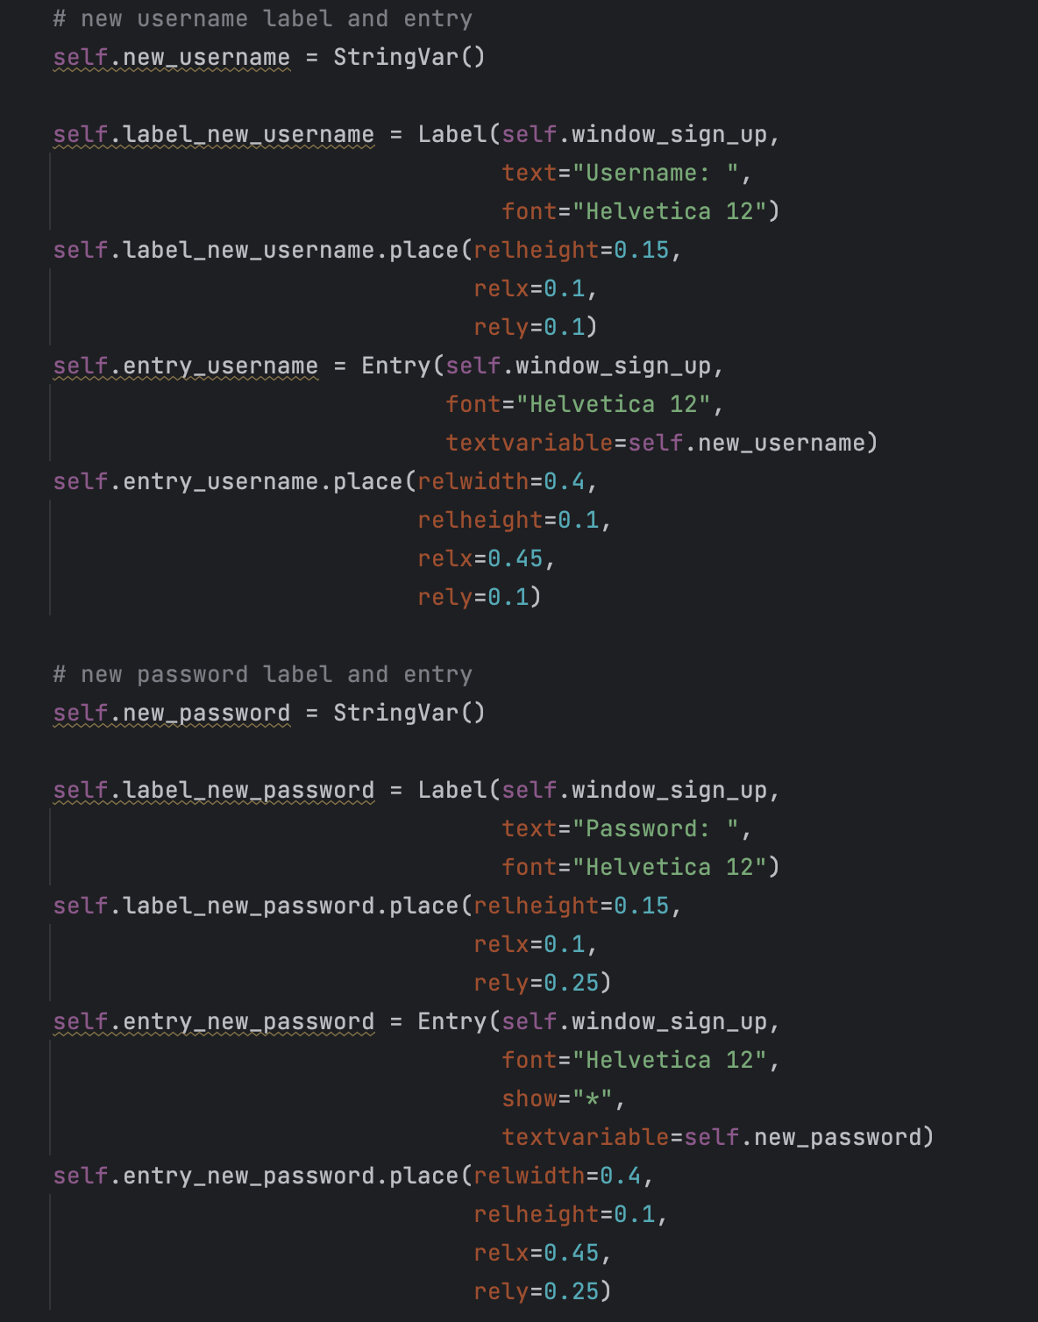
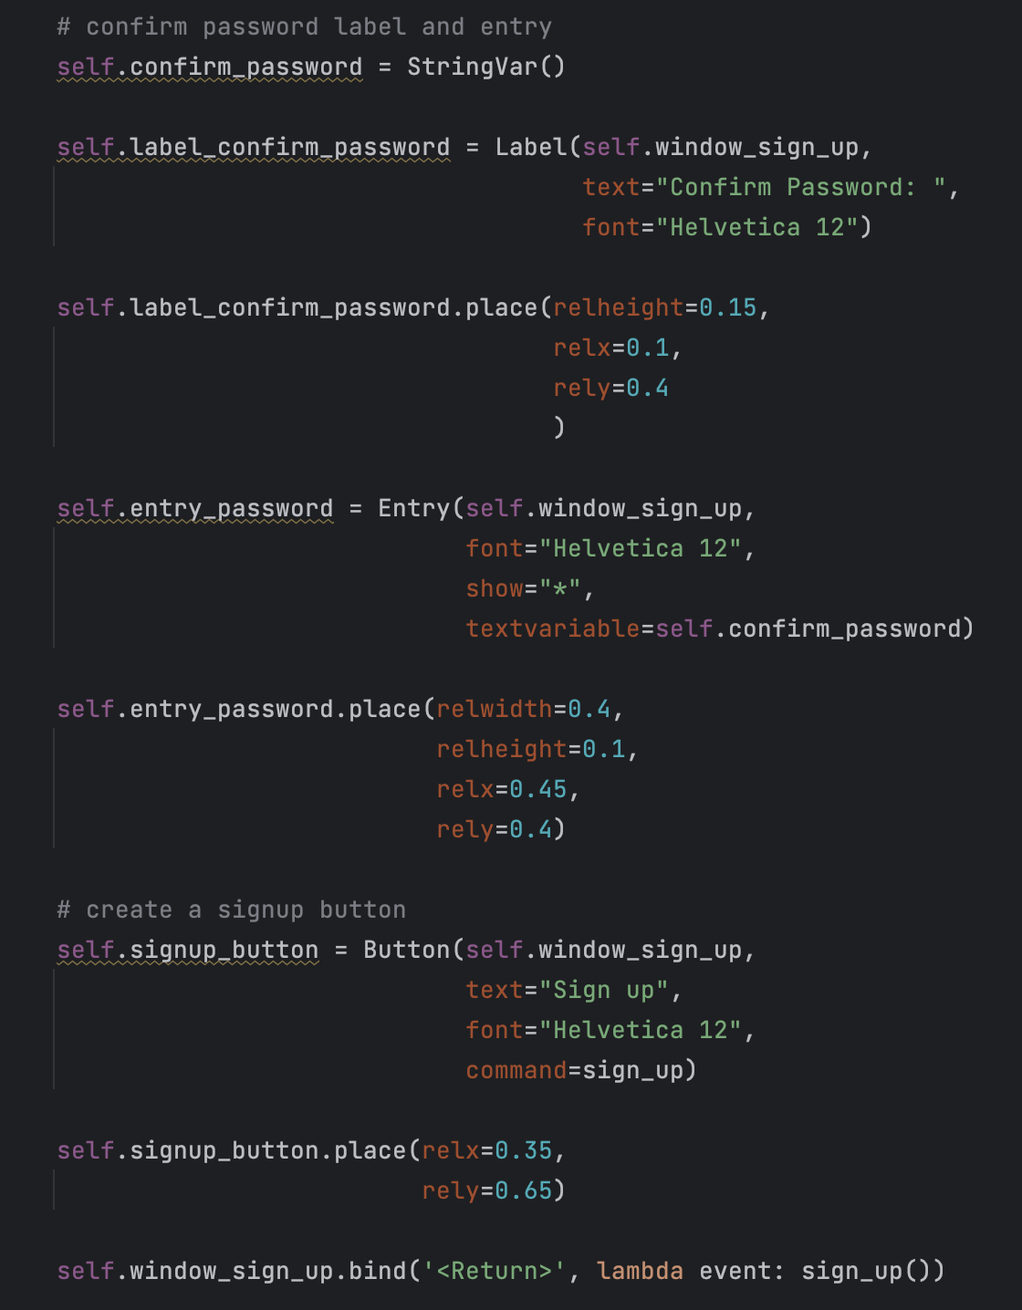
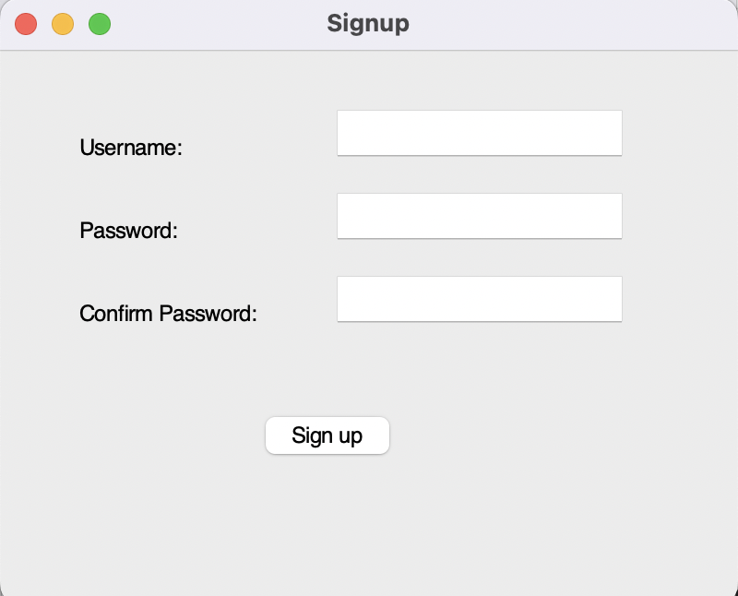
GUI
Sign up window

Slide 11
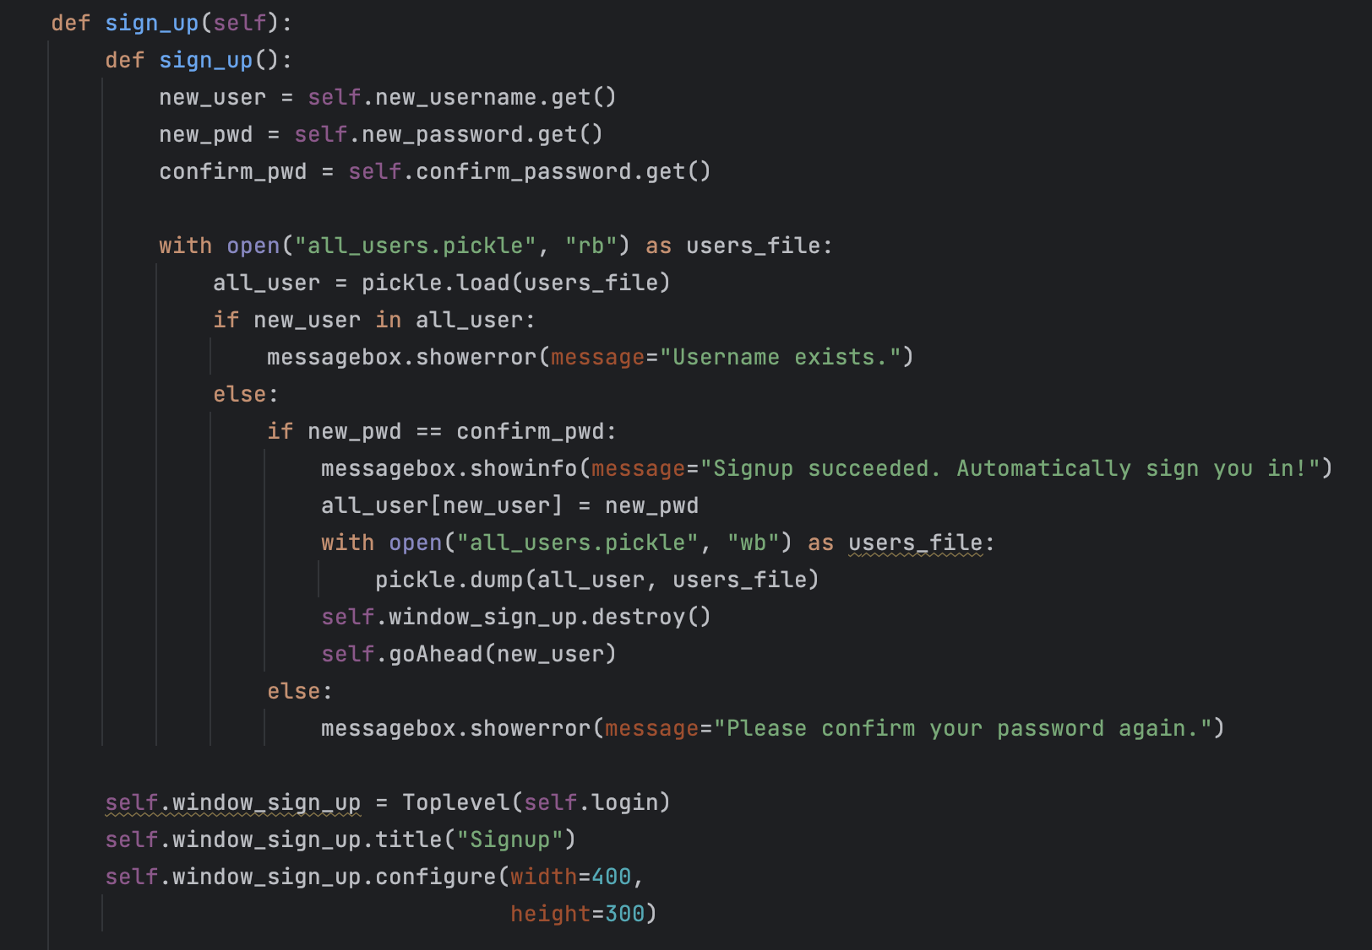
GUI
Sign up action & Automatic login
Automatically sign the new user in
Largely increase user experience

Slide 12
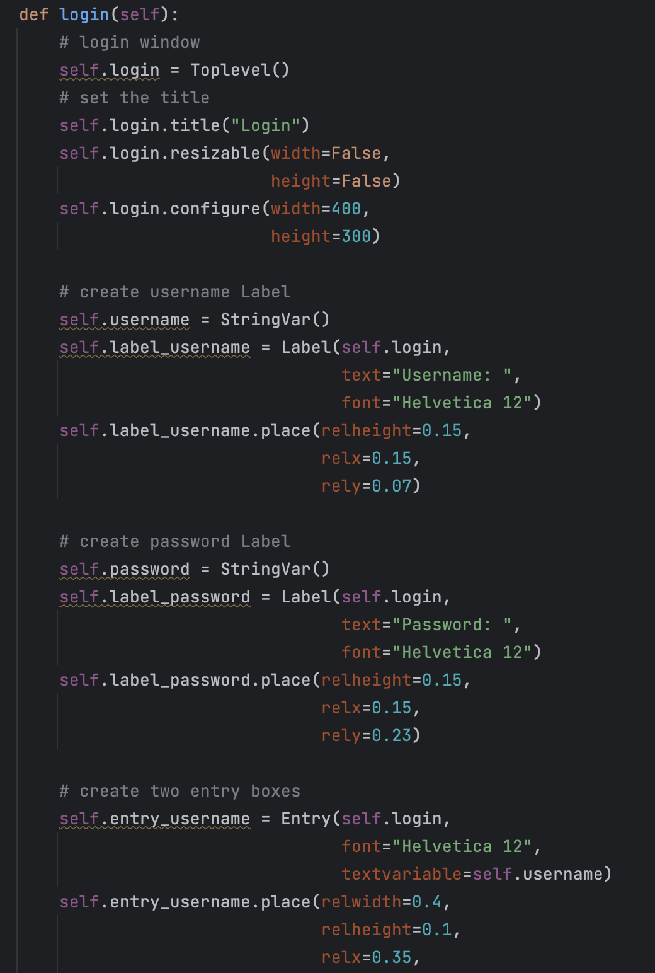
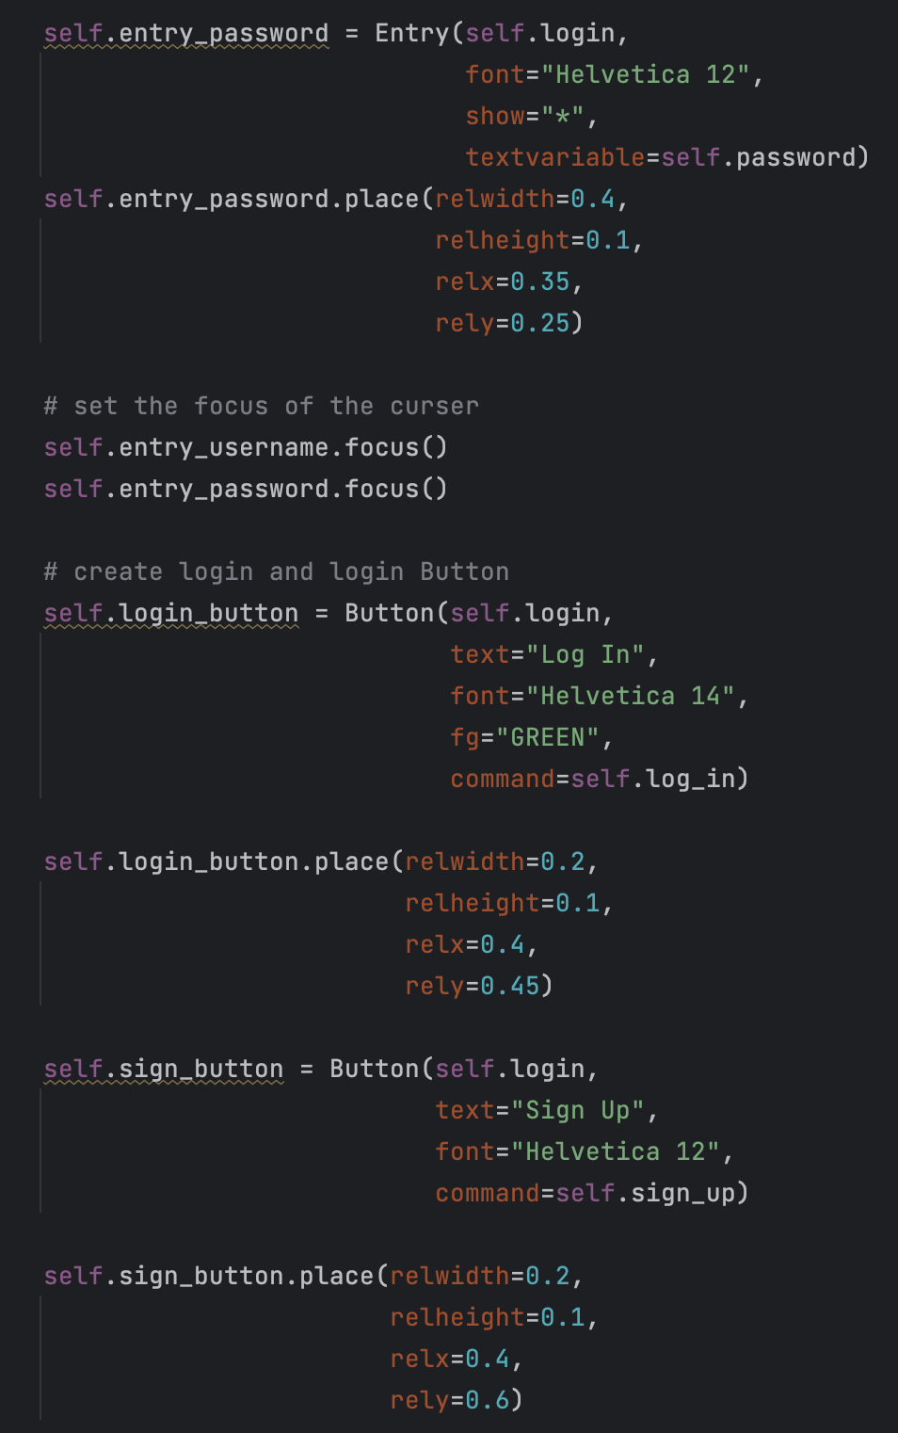
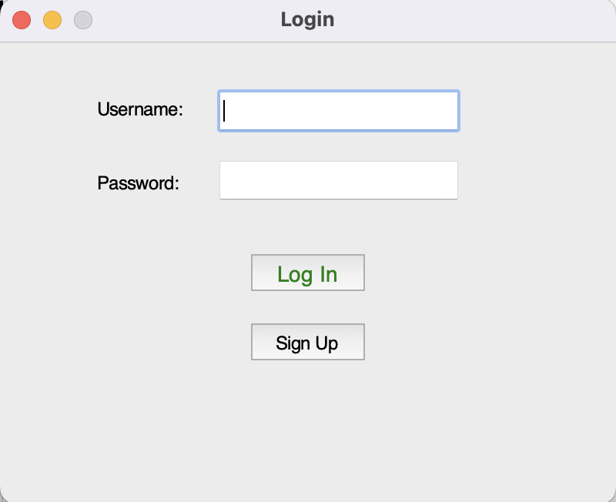
GUI
Log in

Slide 13
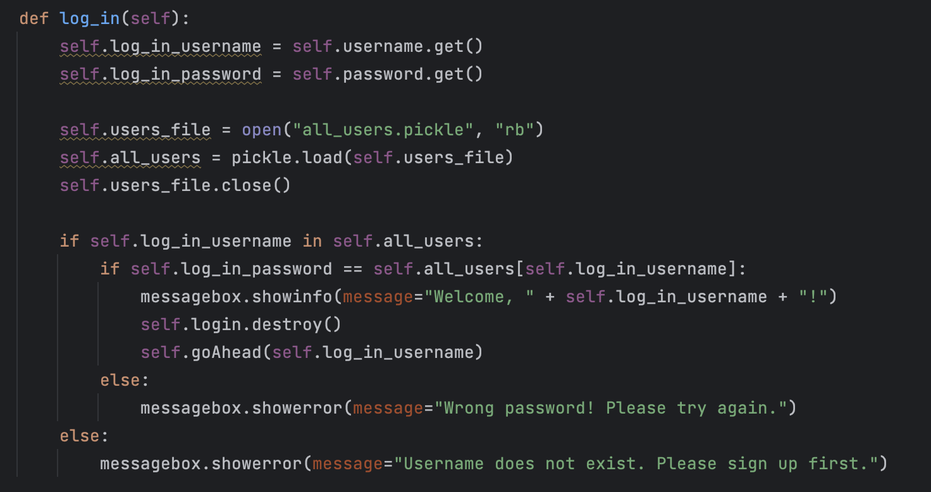
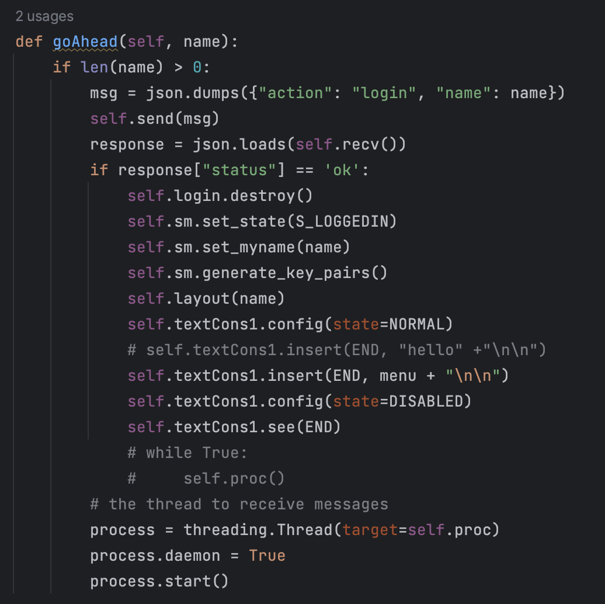
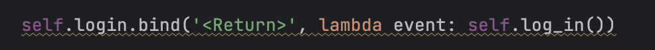
GUI
Log in
Added feature: Can use the key Return to log in
Conform to users’ usage habits

Slide 14
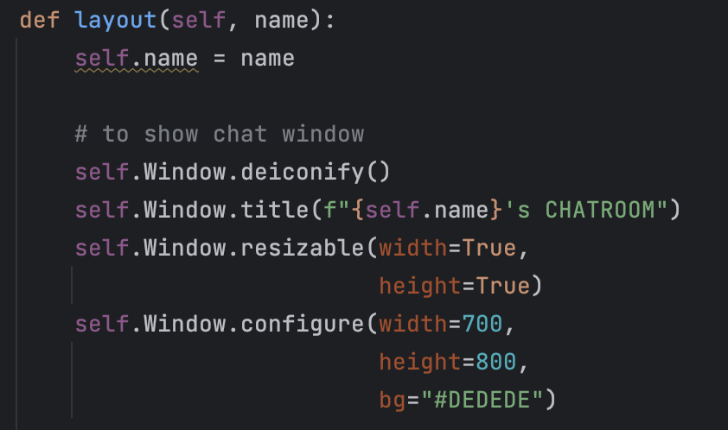
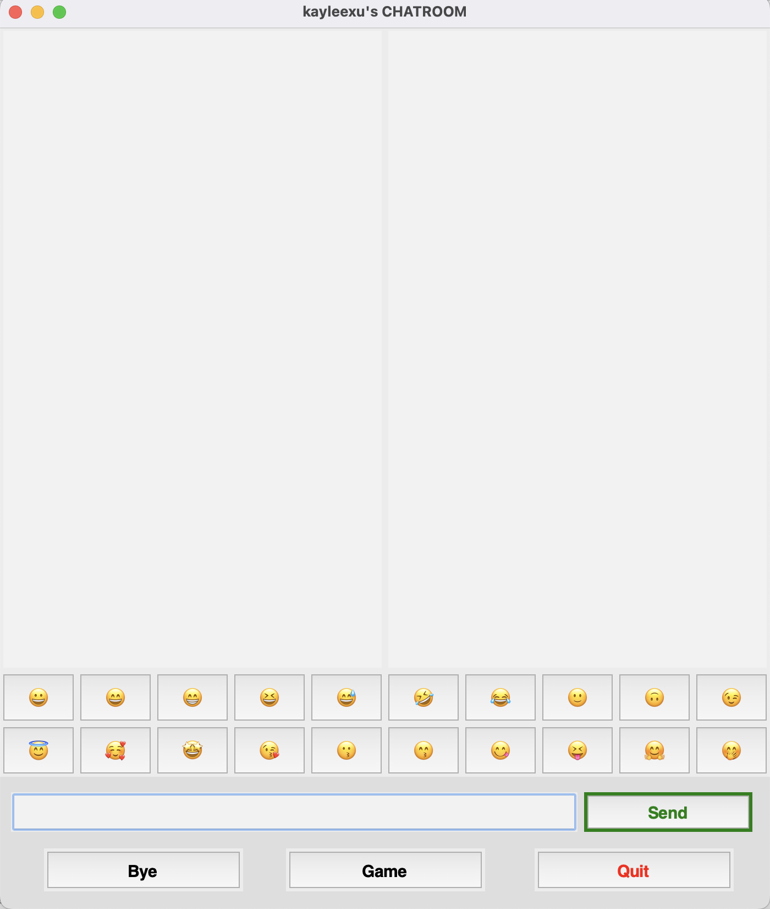
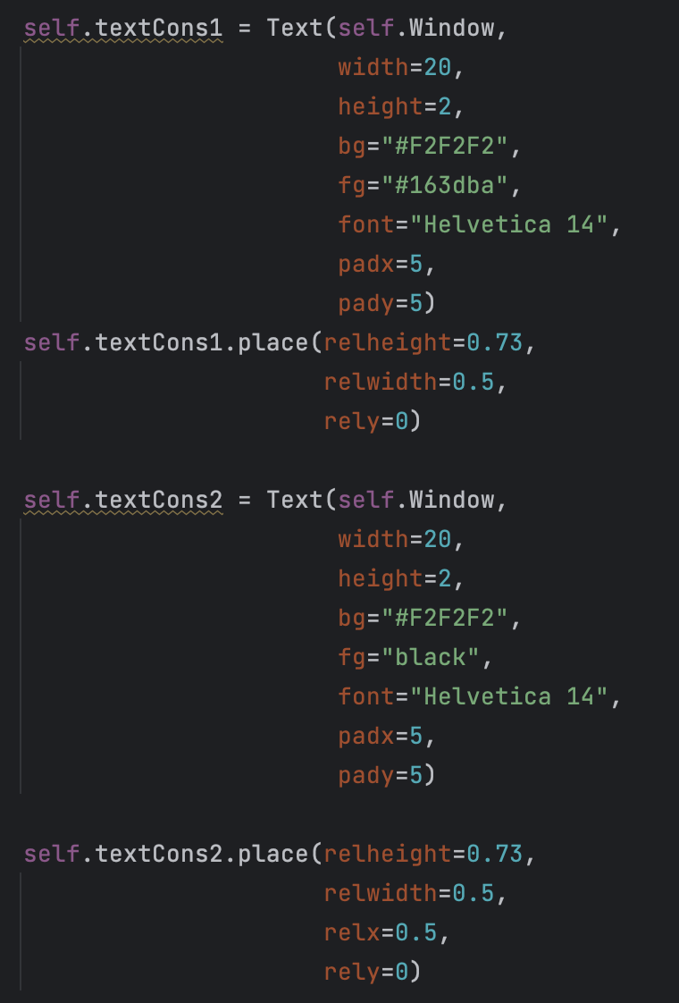
GUI
Chatbox
Mock real social media layout

Slide 15
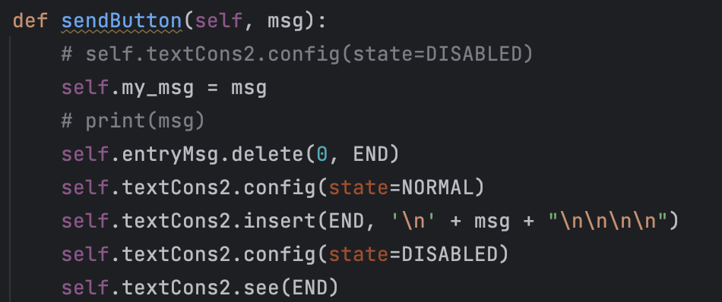
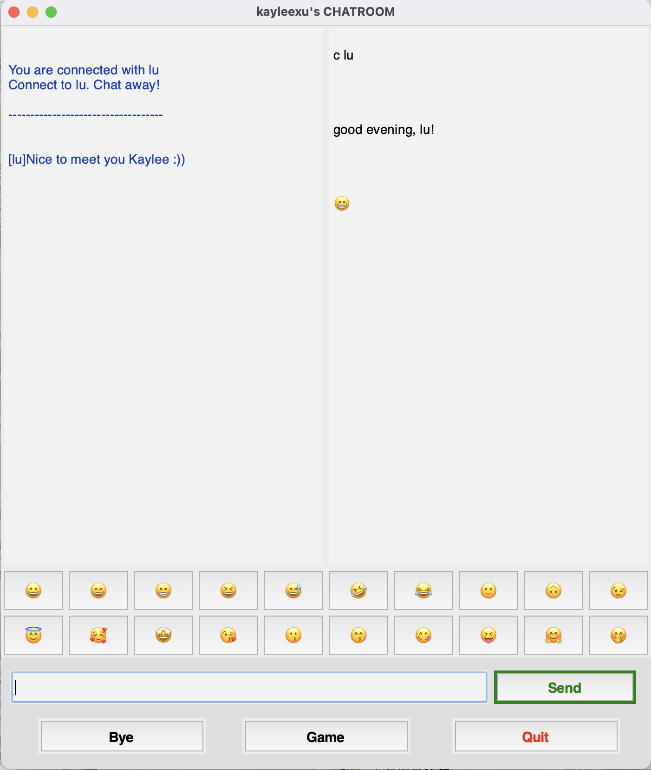
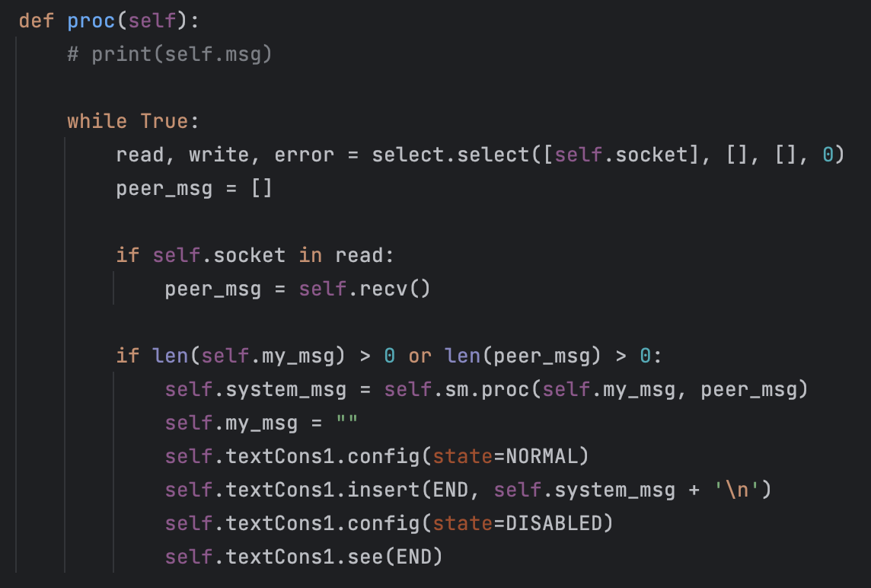
GUI
Chatbox
2-side chatting UI - align with real social media chatbox

Slide 16
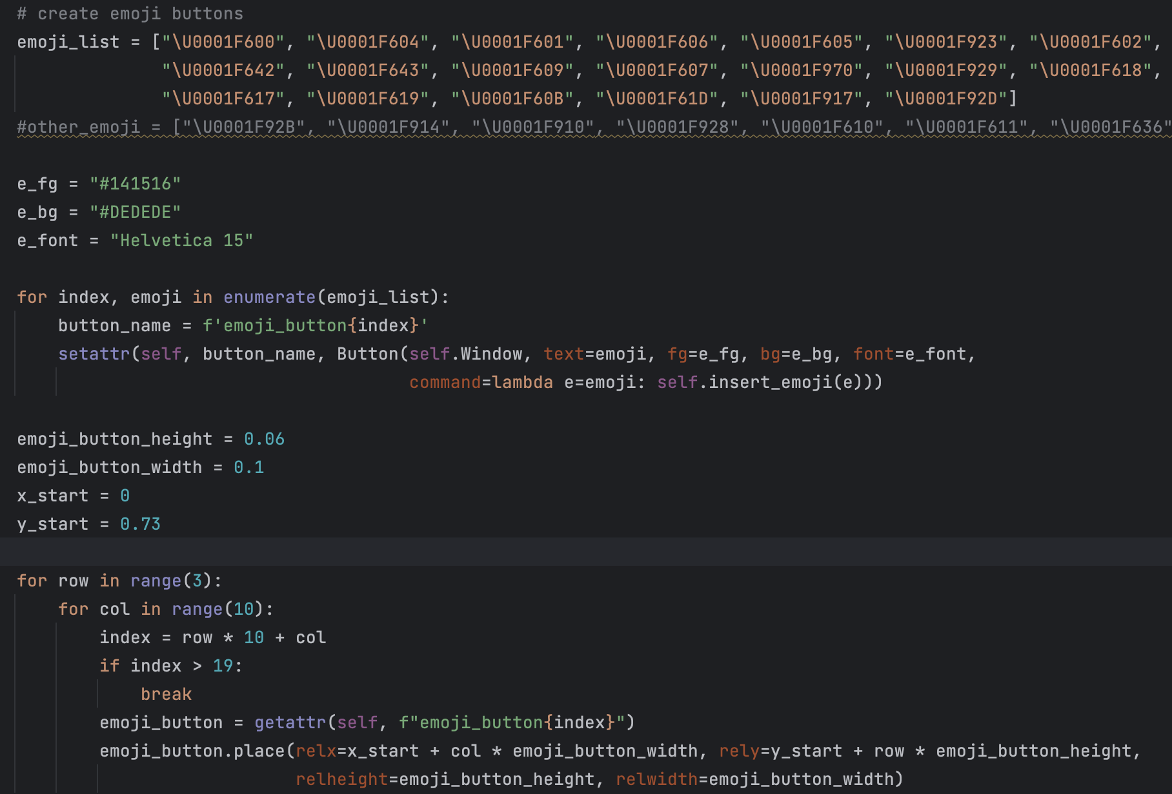
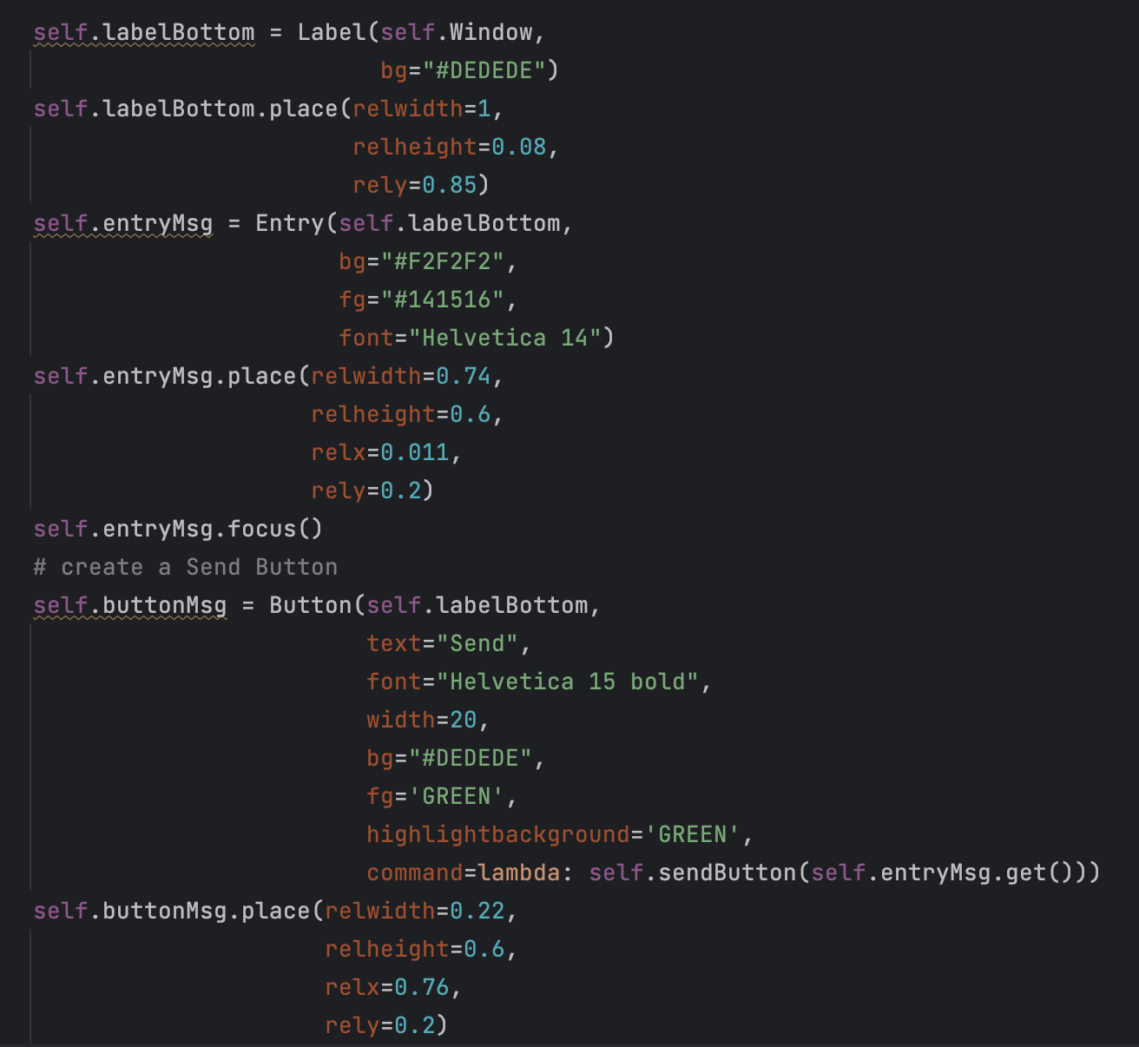
GUI
Chatbox

Slide 17
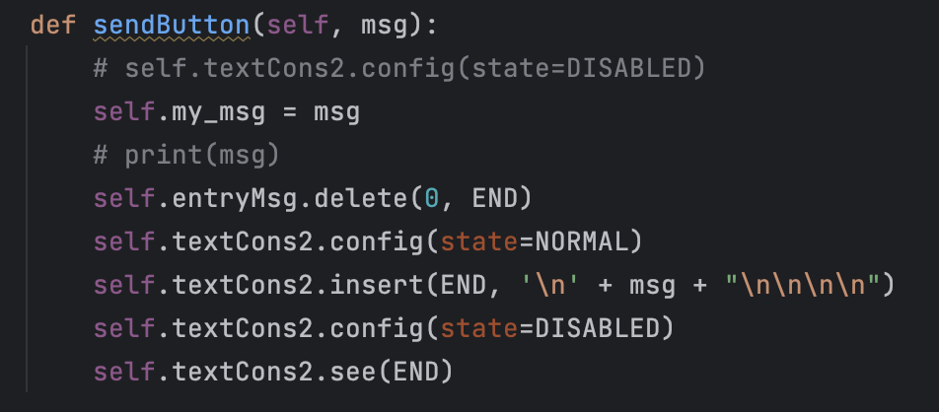
GUI
Chatbox
Can use the key Return to send message

Slide 18
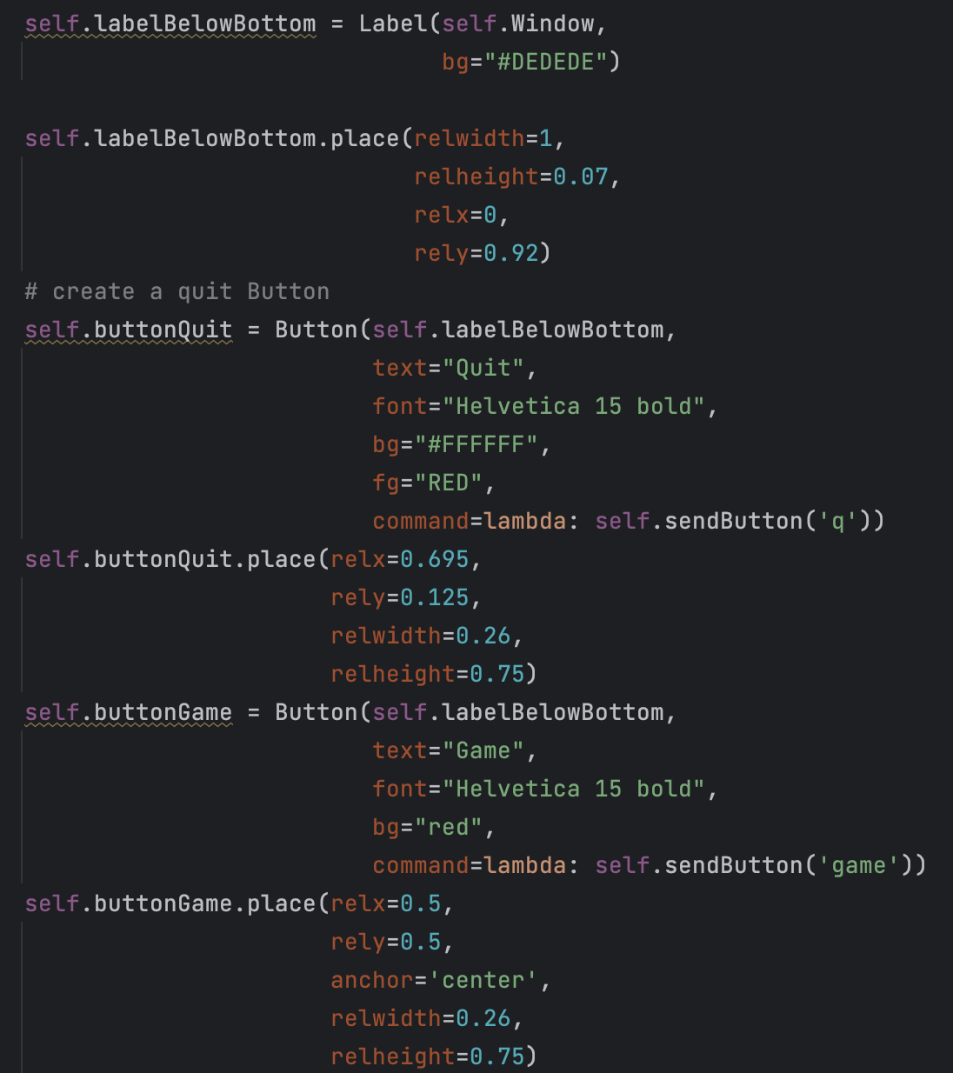
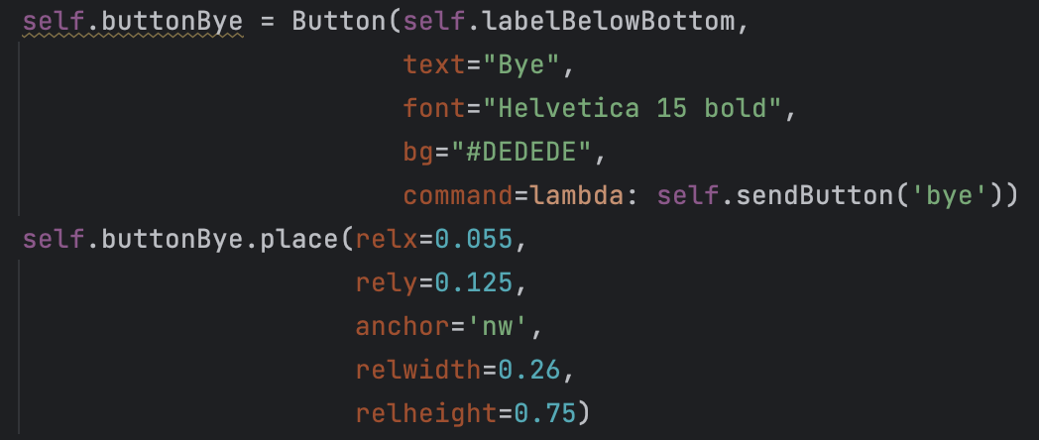
GUI
Chatbox
Use buttons instead of sending messages

Slide 19
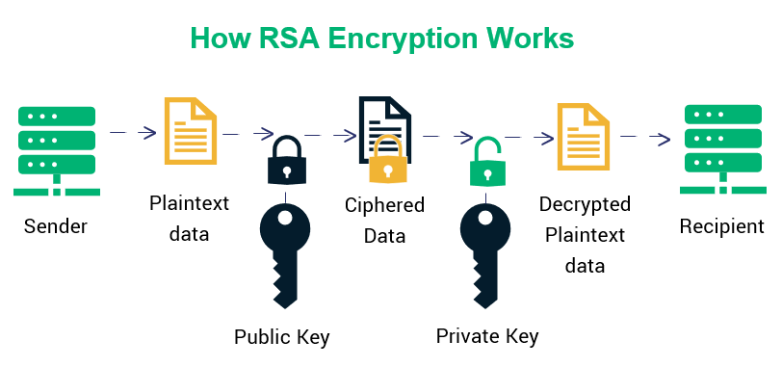
Secure Messaging
Principle

Slide 20
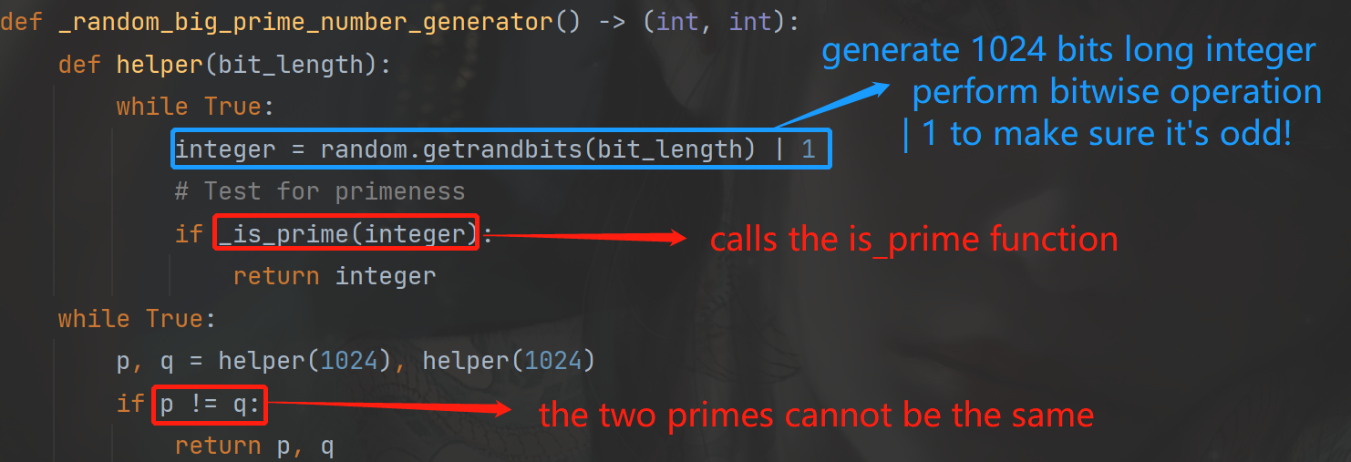
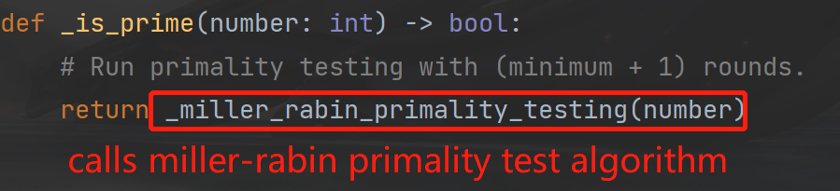
Secure Messaging
Prime numbers generation

Slide 21


Secure Messaging
Theoretical support
Critical question: Why can we brutally search for primes?
Approximated number of primes smaller than the given x

Slide 22


Secure Messaging
Performance optimization
A lot of
power modulo
involved in cipher and decipher!
The performance of power modulo becomes critical

Slide 23
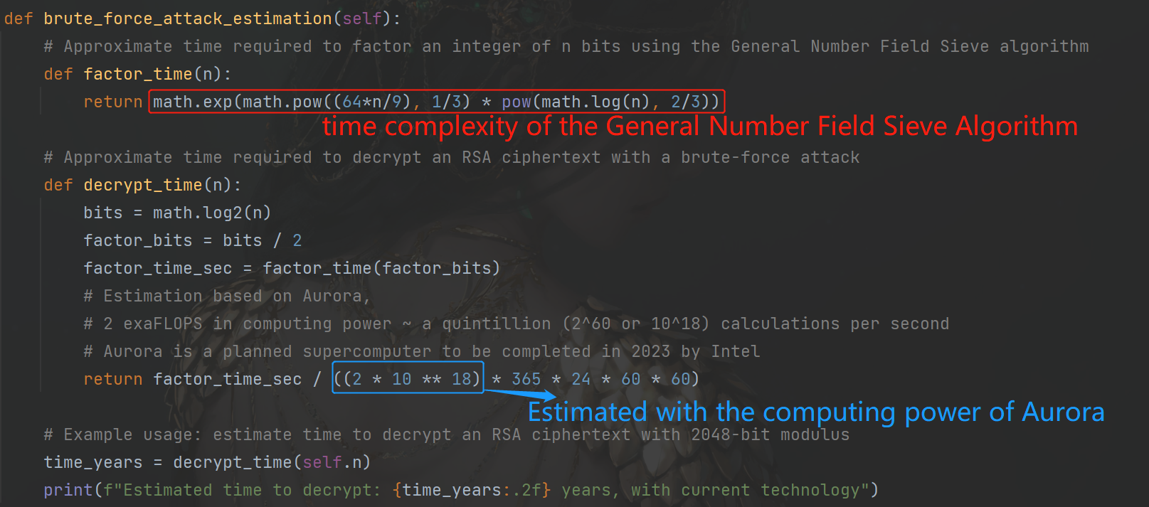

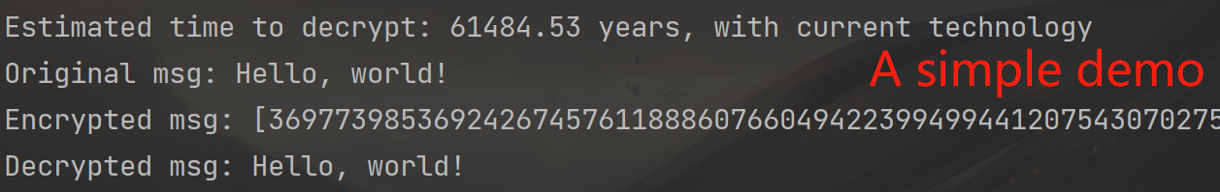
Secure Messaging
Cryptographic strength
How many time is needed to brutally crack the encryption?

Slide 24
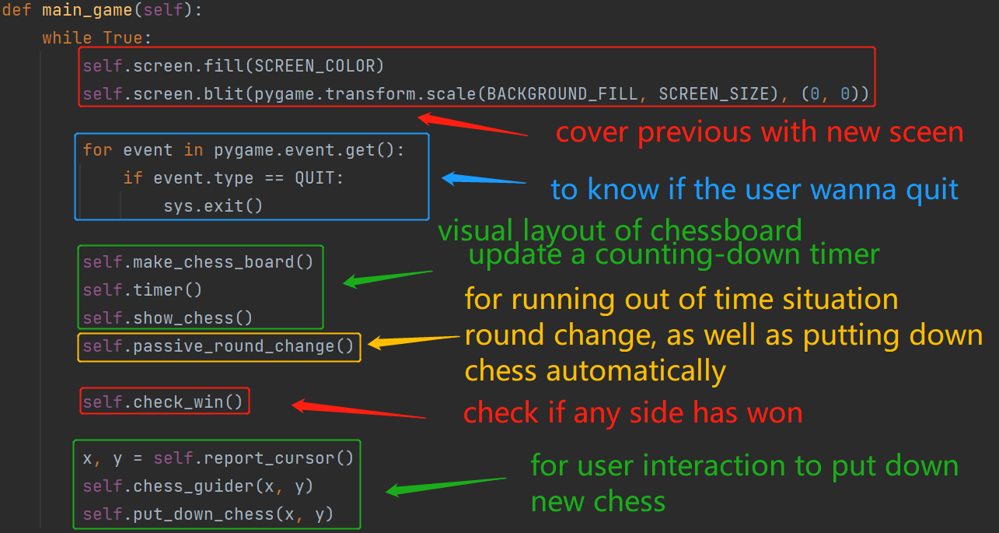
Online Gaming
Overall design

Slide 25
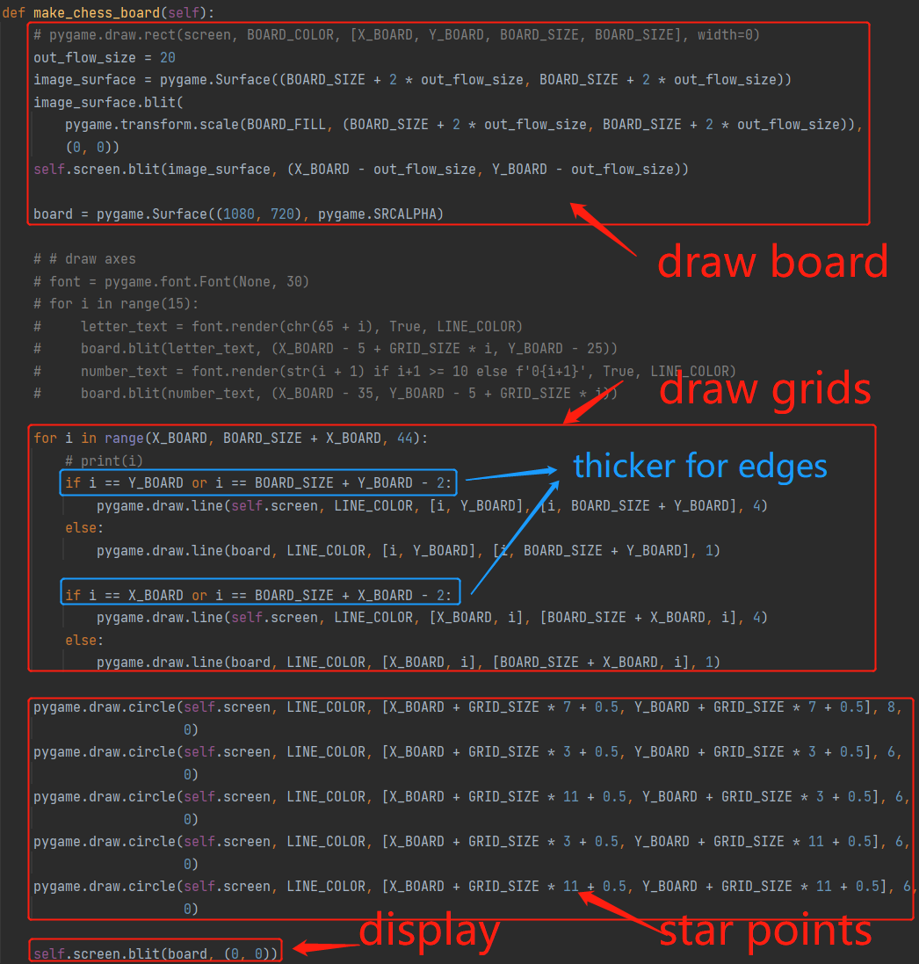
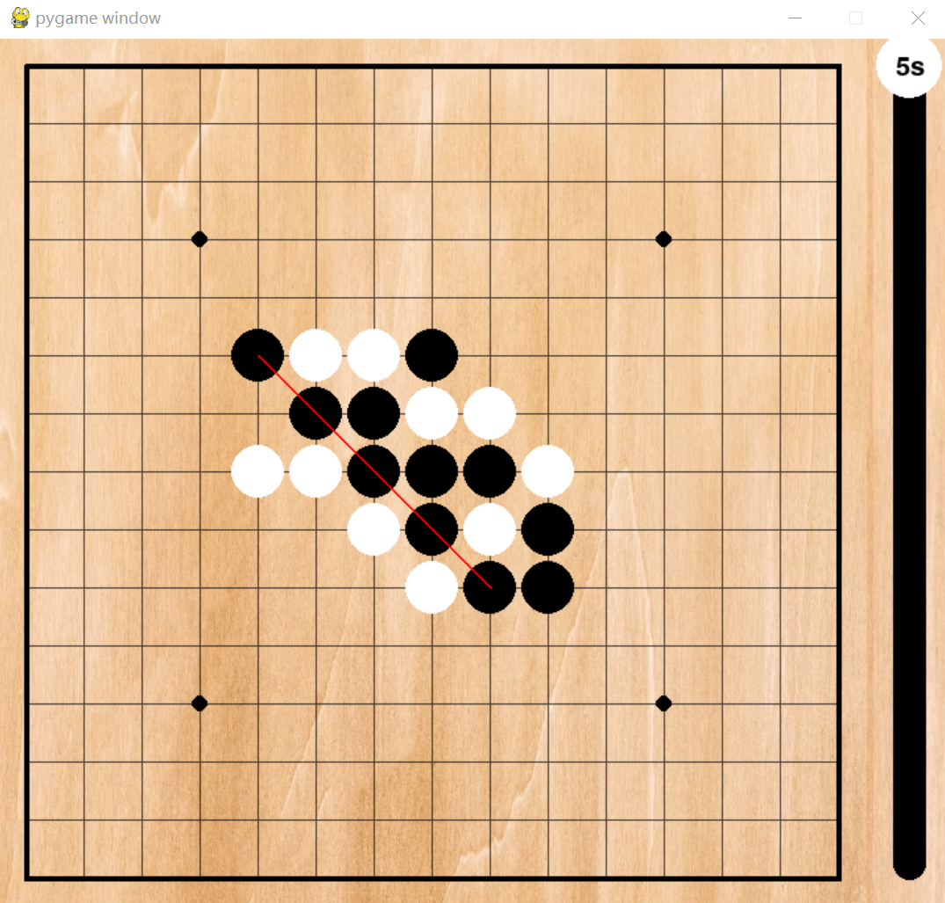
Online Gaming
Visual layout

Slide 26
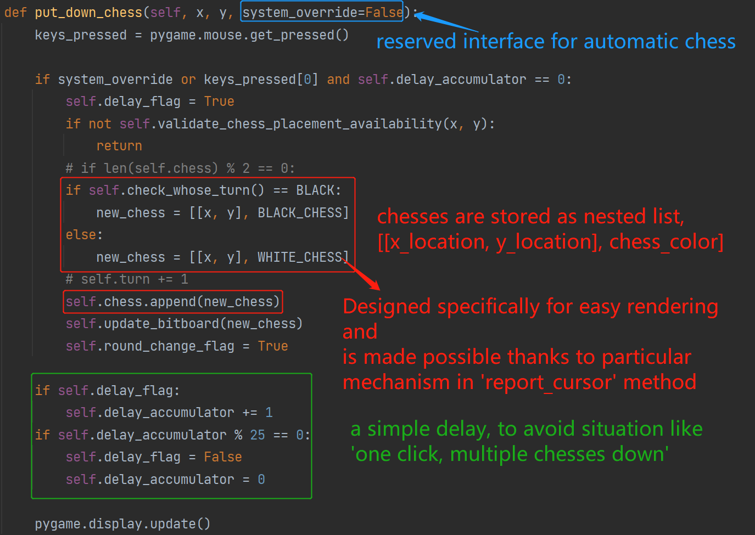
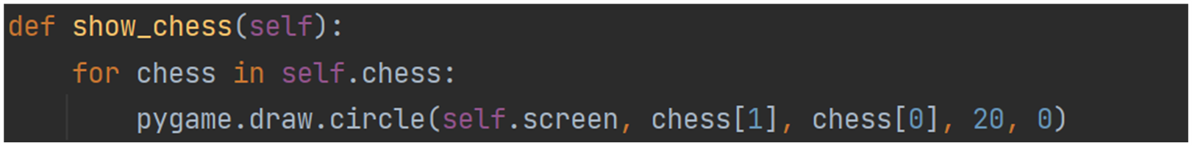
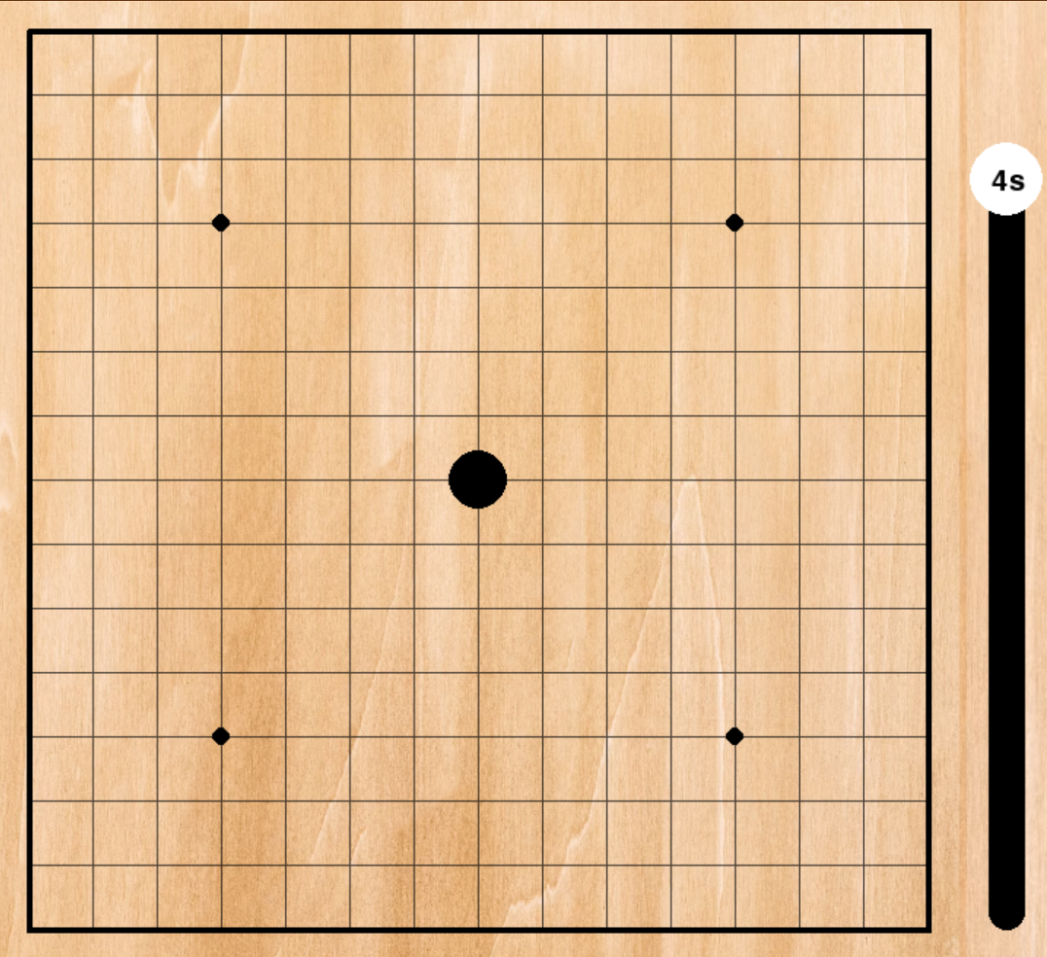
Online Gaming
Chess putting down & position storage

Slide 27
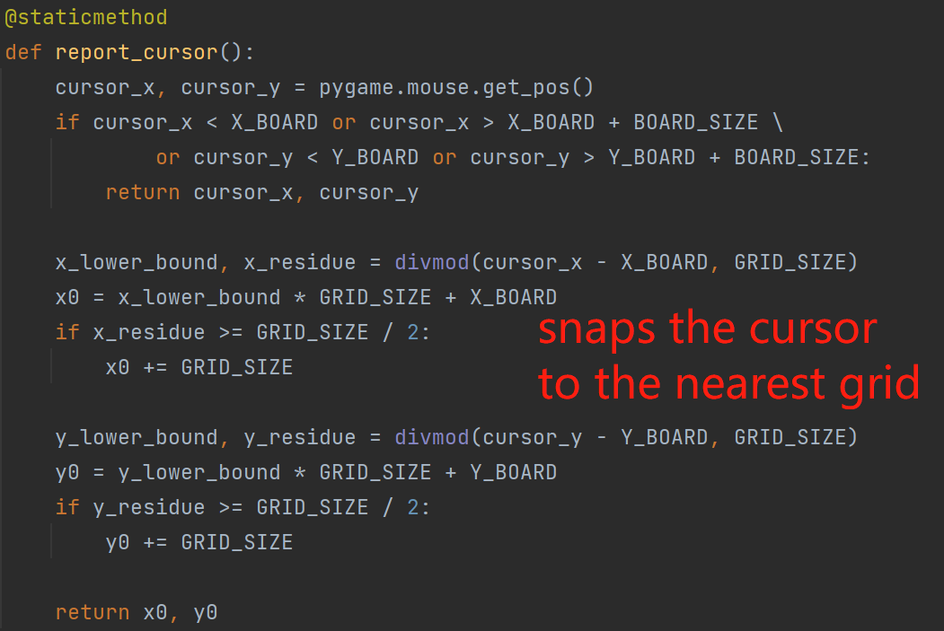
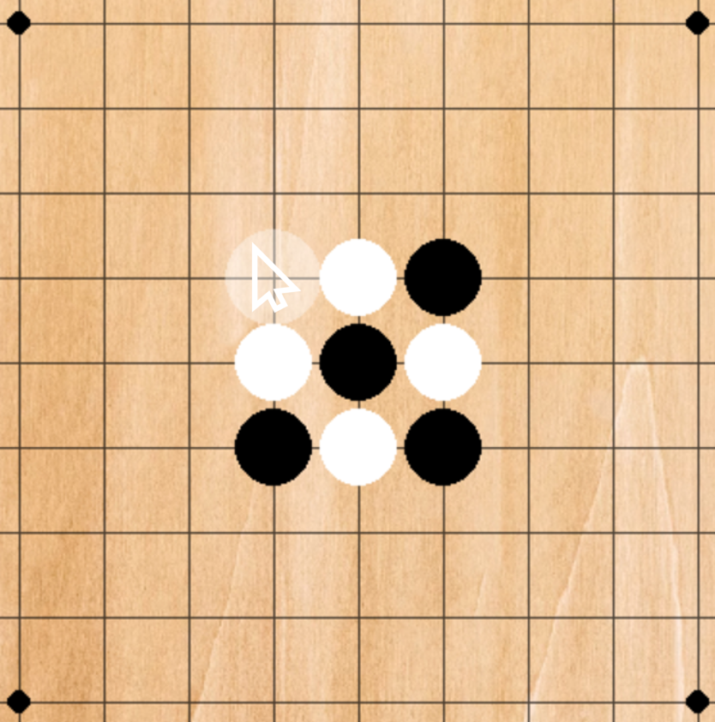
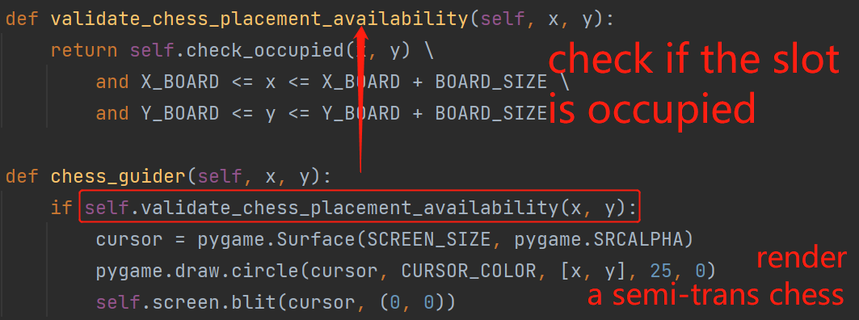
Online Gaming
Cursor control & User friendly visual guide

Slide 28
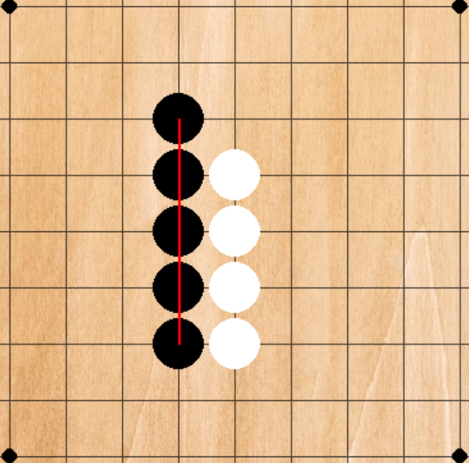
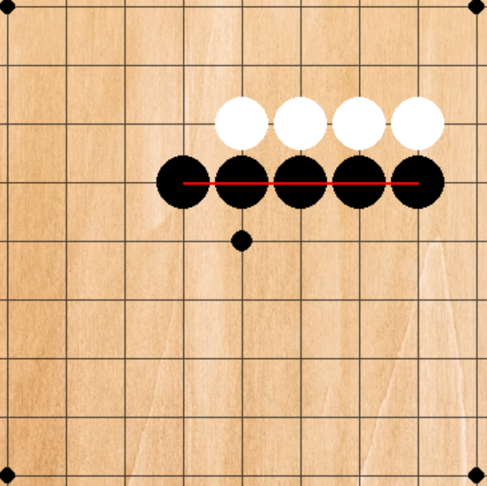
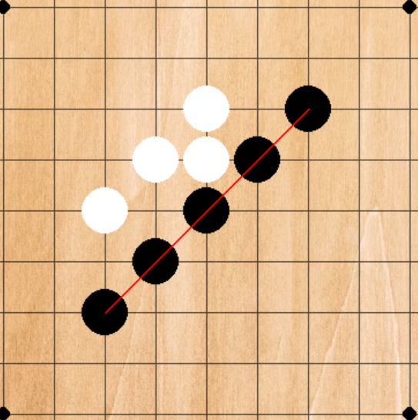
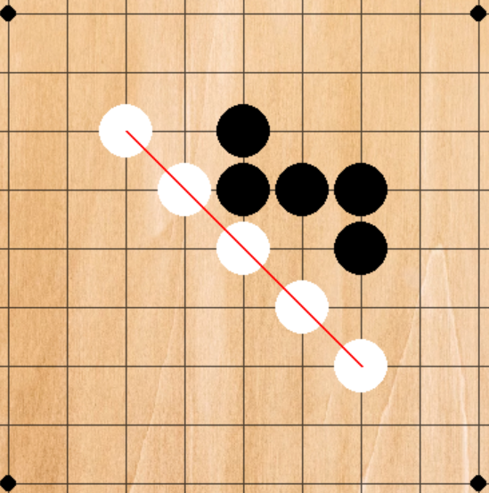
Online Gaming
Win pattern checking
Conventional
Description:
for every slot on the chessboard, perform check operation along four different directions separately
Time complexity:
worst case for 225 slots on the map, 5 * 4 operations are performed on each
4500 operations
In big O notation O(N^2)
Bitboard
Description:
for for directions of winning pattern, traverse with shift and check with bitwise operation
Time complexity:
For four traversals
15*11 + 150 + 168 + 168 =
600 operations
In big O notation O(N)
vs.

Slide 29
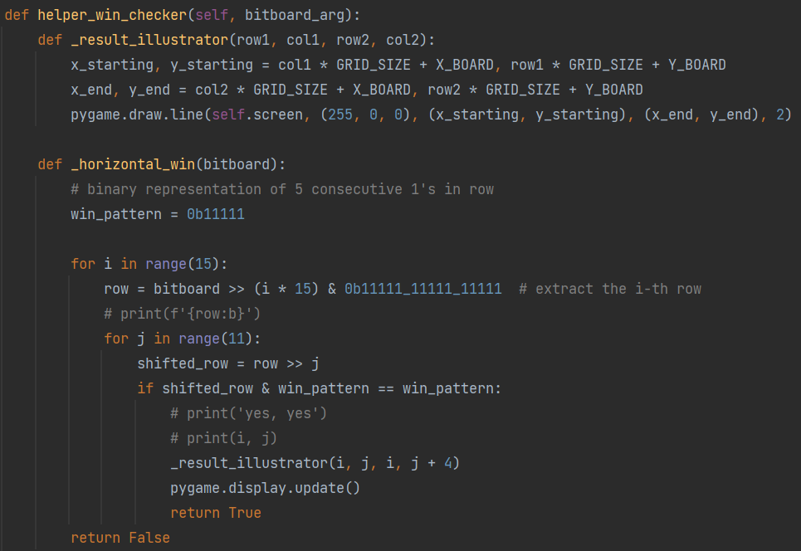
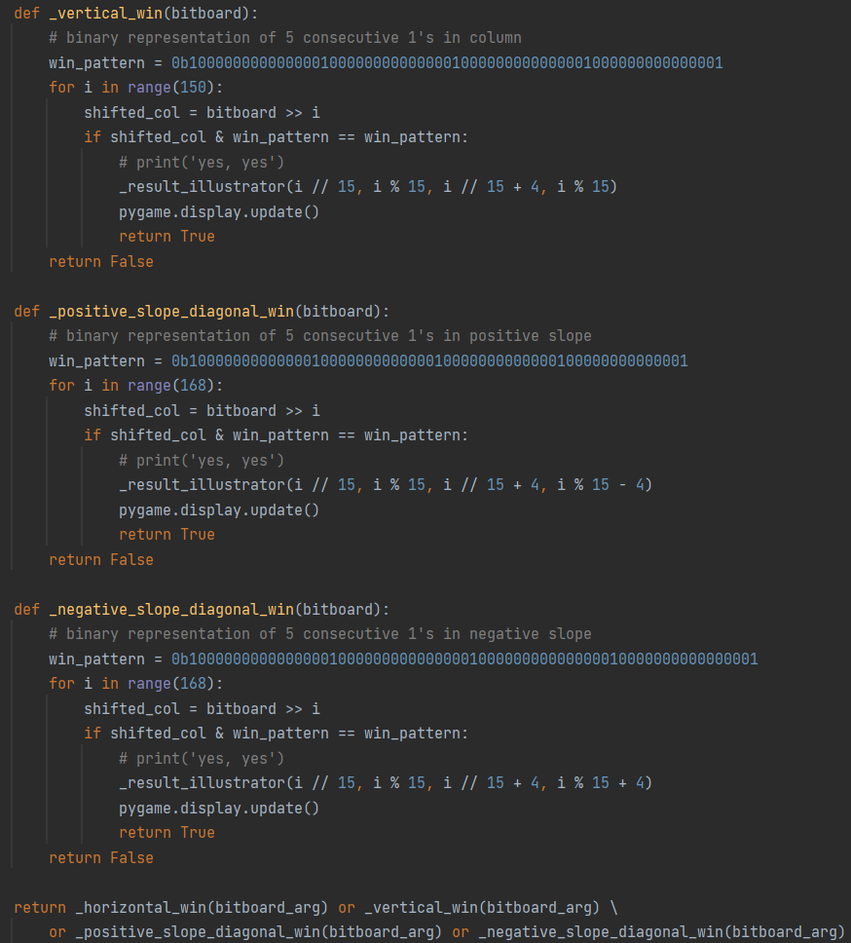
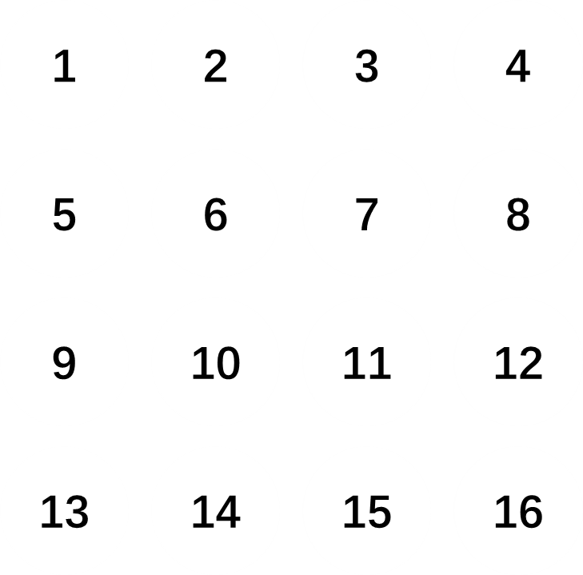
Online Gaming
Win pattern checking optimized

Slide 30

Online Gaming
Win pattern checking
Bitboard
Eventually……

Slide 31
04
Potential
Improvements

Slide 32
To develop this chat system better…
01 | Make sure the new message is below the last message (no matter it’s from peer or self-sent)
02 | Can create an emoji button which triggers a dropdown menu containing all the emojis
03 | Make sure users can quit the game and get back to the chatbox
04 | Add a groupchat function

Slide 33
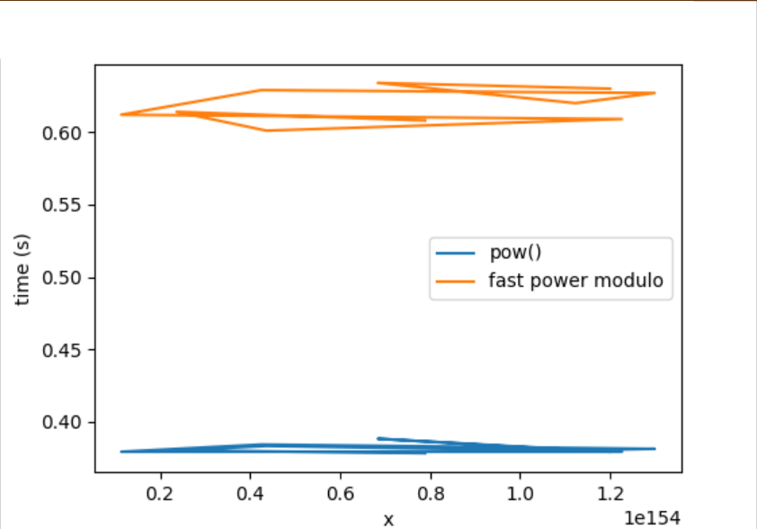
Secure Messaging
Performance optimization
A lot of
power modulo
involved in cipher and decipher!
The performance of power modulo becomes critical

Slide 34
Thanks!
2023/05/14

